Slide 1

Shiny: an R-based framework for web applications
Andrés García Solares

Slide 2







The R language
Used for data science, statistics, data mining
Interpreted language: runs on a command line
Used for data science, statistics, data mining
Interpreted language: runs on its own command line
Functional programming
Open source and big community (many packages, forums...)
like these guys

Slide 3

Shiny
An R package that provides a framework for building web apps
Enables R programs to become end-user applications
Lots of pre-built UI components and widgets
Shiny generates HTML and sends it to the user’s browser

Slide 4


RStudio
IDE with all the usual features:
syntax highlighting
workspaces/projects managing
debugging
And R-specific features:
integration with R environment/CLI
integration with renv (R package manager)
data visualization
RStudio and Shiny are developed by the same company: Posit
We’ll be using RStudio throughout this presentation

Slide 5
The basics of a Shiny app

Slide 6
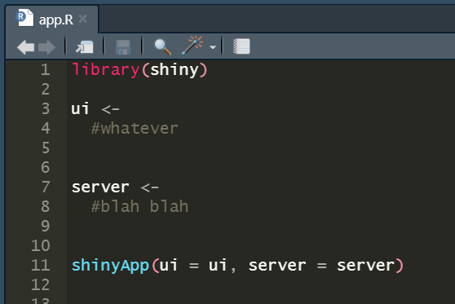
Code structure
A single file (app.R) containing:
A ui object - User interface, visual part of a Shiny app - Declares inputs, outputs and layout
A server object - Where the internal logic of the app is implemented - Updates outputs according to the provided inputs
A call to the shinyApp() function - Takes in the ui and server objects - Returns a shinyApp object

Slide 7
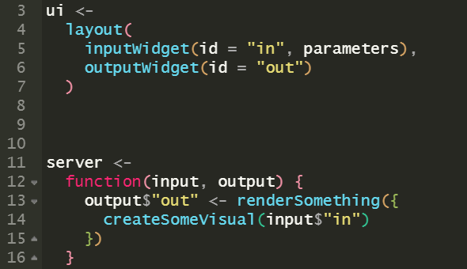
ui object
Shiny provides us with many functions that create pre-built layouts which can be passed as a ui object
Shiny also provides us with many functions that create UI widgets/components (both inputs and outputs)
We can pass those widgets to the layouts to build our UI
(not real Shiny functions)

Slide 8
server object
Function that receives the input and output widgets as arguments
Its purpose is to updates the outputs whenever the inputs change
The body of the function implements the logic and behaviour of the program

Slide 9
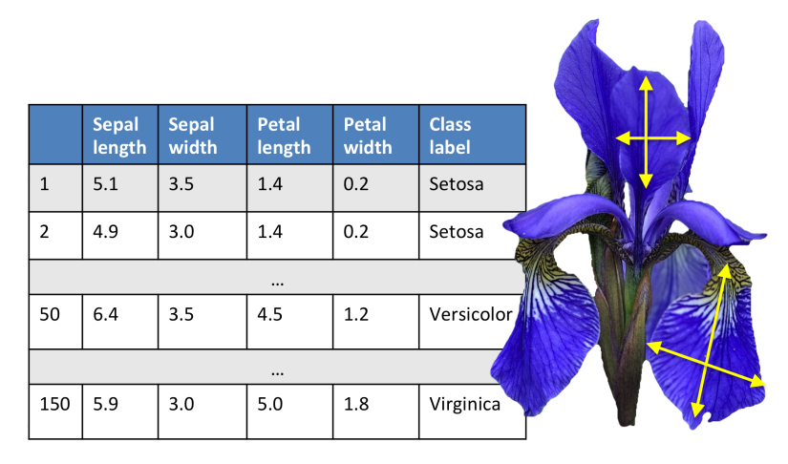
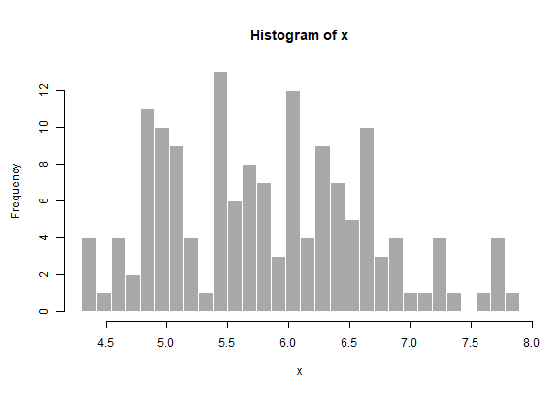
Our first example
The iris dataset: measurements of different “iris” flowers
We are going to create a histogram
The user will be able to interact with the histogram on the fly using some input controls

Slide 10
Demo time!
Interactive histogram

Slide 11
Building the UI

Slide 12

Input widgets
The framework provides many input components called widgets
They are created by calling a widget function
Widget functions take in the following arguments: - inputId: unique ID used to refer to that specific widget - label: text label to be displayed next to the widget - extra arguments, specific to each particular widget
Under the hood, Shiny is using Bootstrap, a very popular CSS framework

Slide 13
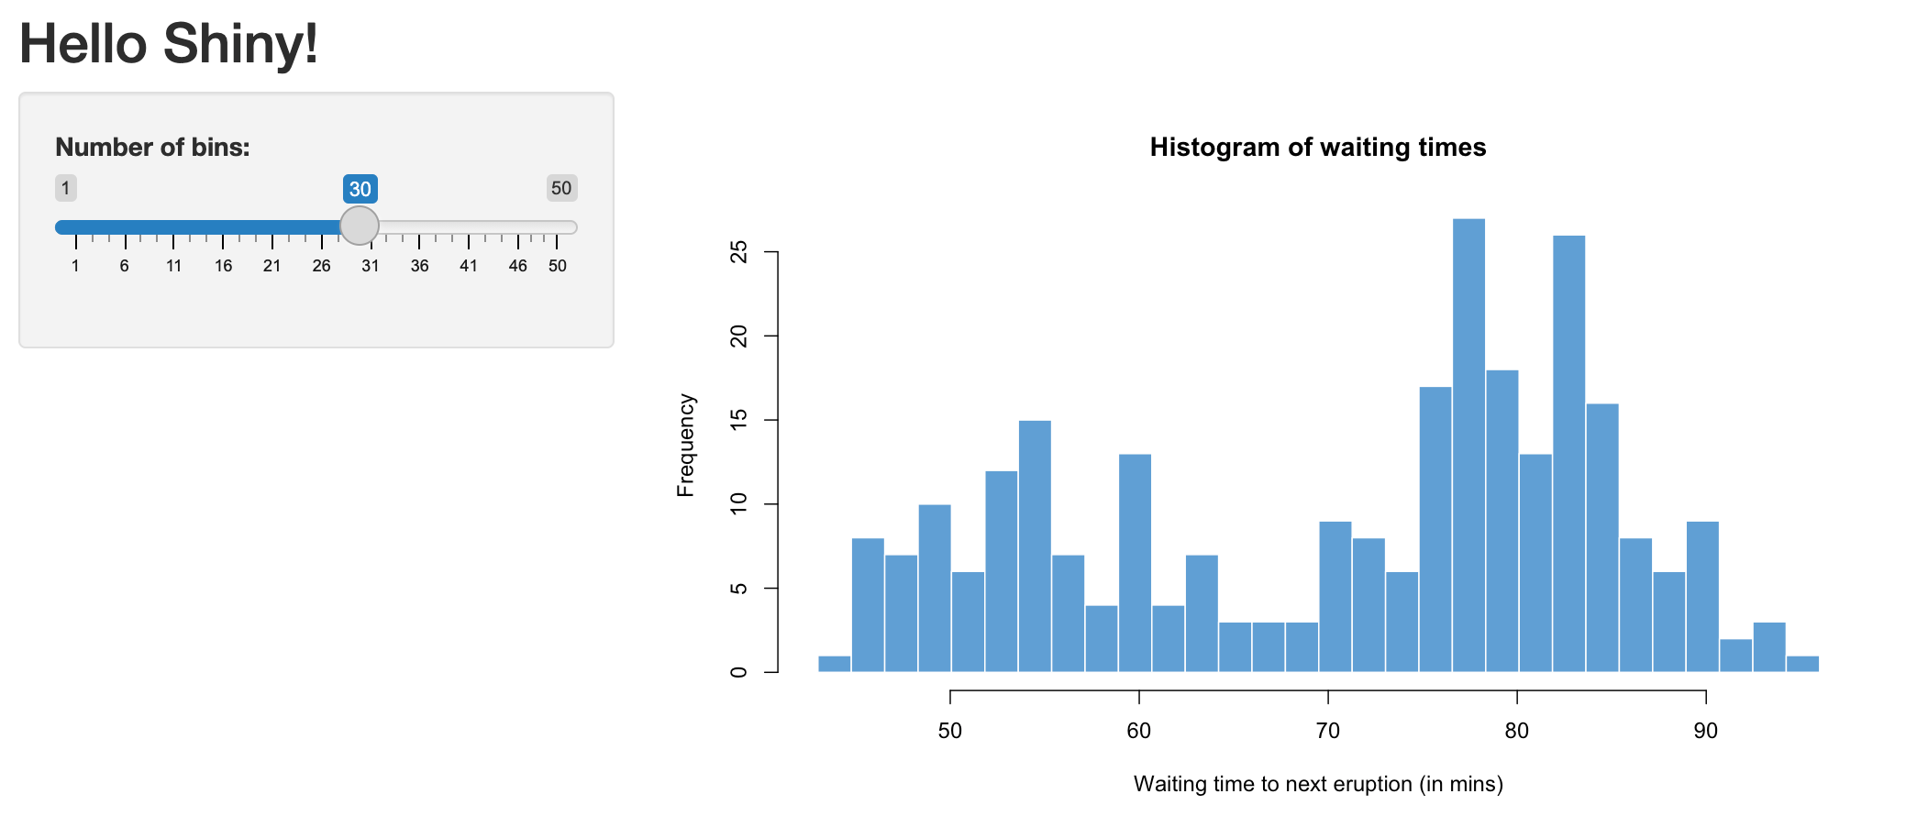
Layouts
The framework provides different layouts to organize the UI
They are created by calling a function that takes widgets as arguments and places them in the layout
Sidebar layout

Slide 14
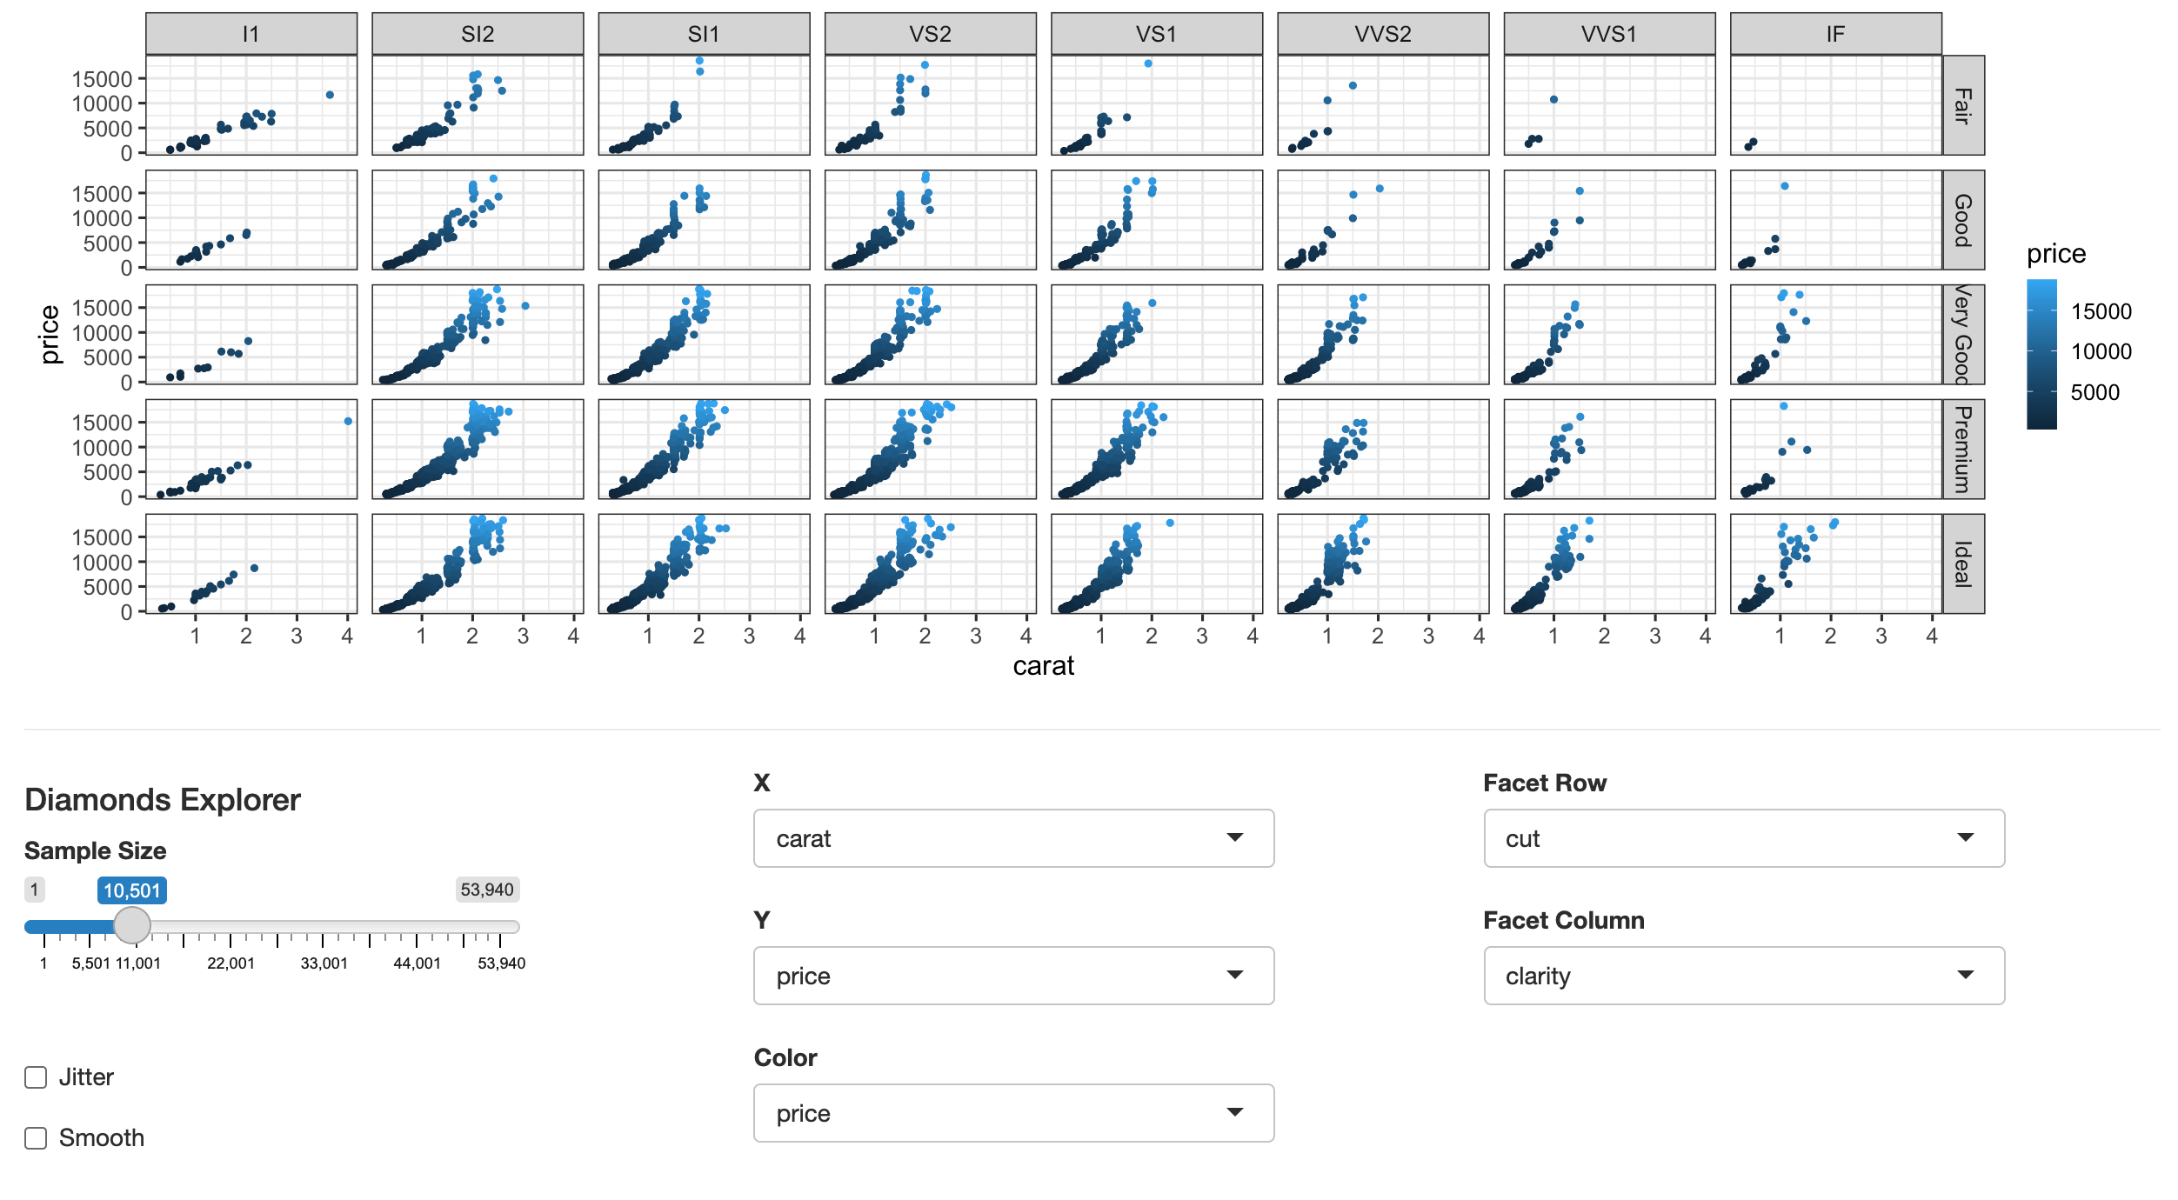
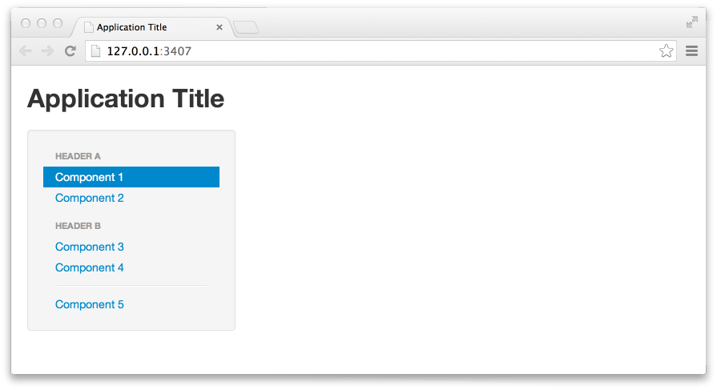
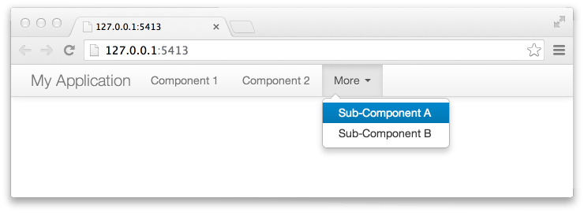
Layouts
Grid layout (supports fluidRow)
Navbar
Navlist

Slide 15
Demo time!
Input showcase

Slide 16


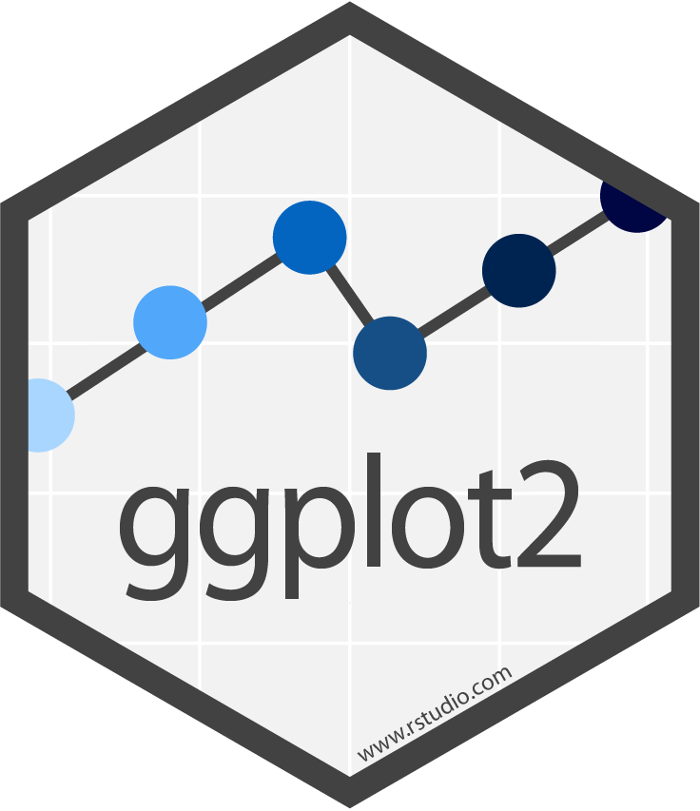
Output widgets
The UI not only has inputs, it also has outputs
The framework provides many output components
They are created by calling functions that take in the following arguments: - outputId: unique ID used to refer to that specific output - extra arguments, specific to each particular widget
We can call functions from R’s powerful libraries for plotting, data manipulation, etc. and render the results into Shiny output widgets

Slide 17
Demo time!
Output showcase

Slide 18
Reactivity

Slide 19
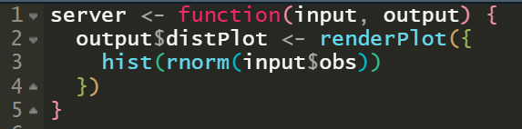
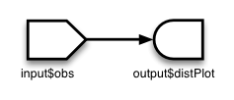
Intuitive notion of reactivity
=
output$distPlot depends on input$obs
Shiny keeps track of these dependencies automatically
When the value of input$obs changes, Shiny re-calculates the value of output$distPlot so the dependency stays consistent

Slide 20
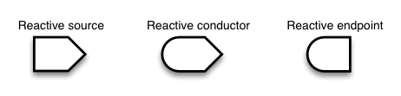
Let’s get technical
The concept
Shiny’s implementation
Reactive values
Reactive expressions
Observers
(These are optional)

Slide 21
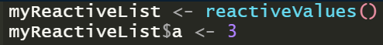
Reactive sources
Whenever a reactive source’s value changes, it notifies all reactive conductors/endpoints that depend on it
Shiny’s reactiveValues objects are named lists of reactive sources
The input list is exactly that
We can declare arbitrary collections of reactive values:

Slide 22
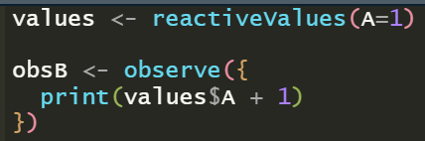
Reactive endpoints
Reactive endpoints AKA “observers” are functions that: - cache the value of the sources they depend on - listen to changes in the sources’ values - re-run when those sources change
Shiny’s observe({}) creates an observer with the code that it receives as a parameter
We can declare arbitrary observers:

Slide 23
Reactive endpoints
Here’s the trick: observers don’t return values!
They are used for the side effects of their execution (such as printing, or sending data to the browser)
In this case, renderPlot() is an observer that draws a plot. When we assign it to output$distPlot, Shiny connects it to the corresponding output widget. That way, the widget updates reactively.

Slide 24
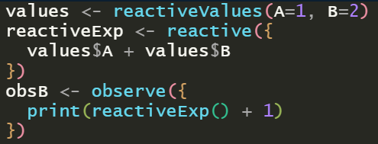
Reactive conductors
The best of both worlds: a conductor AKA “reactive expression” is: - like a reactive endpoint (listens to changes in reactive sources) - like a reactive source (returns a reactive value)
Shiny’s reactive({}) creates a reactive expression:

Slide 25
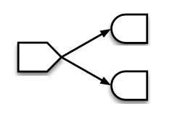
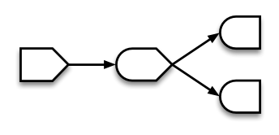
What’s the point of reactive conductors?
= slow computation
Like a regular variable, but with reactive behaviour: it allows us to cache an arbitrary function and use it as a reactive source

Slide 26
Demo time!
Reactive conductor

Slide 27
Deploying Shiny apps

Slide 28




Many options:
Shiny Server
ShinyProxy
shinyapps.io
- Traditional web server - Receives request from client, runs app, sends HTML to client - Can be difficult to scale
- Containerized approach - Can take advantage of:
- Cloud/PaaS - Provided by Posit - There is a (very limited) FREE plan!
You run your own infrastructure
shinyapps.io (Posit) runs the infrastructure

Slide 29
Some cool public Shiny apps
https://opndt.shinyapps.io/bloodbank_india/
https://dgranjon.shinyapps.io/shinyMons/
https://phillyo.shinyapps.io/intelligentsia/

Slide 30

The end!
You making Shiny apps after learning all this
Any questions?
The code: https://github.com/andresgsol/winter-campus-2022-shiny

